Slide 1

MIDTERM presentation Barcode CHECKER 7681
By: Omar Sharafy, Muhammad Biadsy
Instructor: Mony Orbach
Lab: HSDSL
Spring Semester 2024

Slide 2
BACKGOUND & Motivation
In Hospitals, Samples are collected from patients and labeled with unique barcode stickers.
Visual Checking: In the lab, samples are checked visually against patient barcodes in the system.
Potential Issues: High number of samples can cause confusion and mix-ups, resulting in issuing wrong meds and treatments.
Difficulty in Comparison: Visual comparison of barcodes is challenging for lab personnel (Or any human for that matter).

Slide 3
Goals
Development of an easy to carry and simple tool that solves the problem of confusion in the hospital laboratory .
The tool should :
Compare between barcodes and give us a clear result.
Provide a log with all the scanning results.
Mobile, compact and Re-chargeable.
communicatee via Wi-Fi with a computer.

Slide 4


Components & work development
Components :
Barcode reader (Including built in buzzer).
Esp32.
Screen - SPI TFT LCD.
Realtime clk.
Charger – USB Type-C.
Sd card.
LEDs.
Work development :
Arduino developing environment.
Notes:
Barcode Dimension 2.6*5.6*5.6cm
Screen 4.2 * 3.9 inches

Slide 5

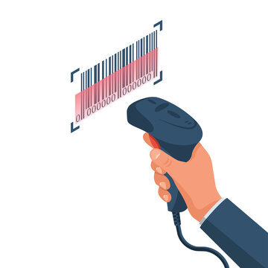



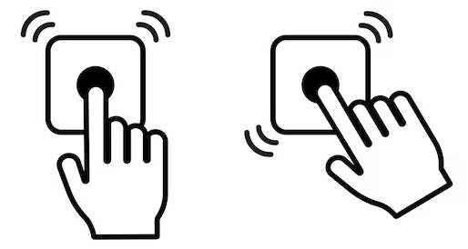

TOP VIEW Block diagram
Outsider PC
WI-FI
Interface
User
DEVICE
Target Barcode

Slide 6
Mod of work Diagram
Show the result via sound + screen & LED’s, and save the result
start
Scan the “Golden barcode”
Scan the target barcode
After each comparison, we will log both the Golden and target barcodes, along with the results, time and date of scanning.
When the device’s memory is full, the user can decide if he wants to override some results or delete all and start a new log.
The log record can be accessed via WI-FI.

Slide 7
Block diagram
Charger
Power Supply Unit
PMU
RTC
LEDs
Outsider PC
Screen
ESP32
WI-FI Interface
Buzzer
Barcode reader
Switches
SD card

Slide 8
Power MNAGMENT UNIT
Input 5V
DC/DC Converter
Output 5V
For Barcode reader
DC/DC Converter
Output 3.3V
For ESP32 & other components

Slide 9
Communication Diagram
RTC
Outsider PC
I2C
WI-FI
ESP32
Display
SPI
UART
Barcode Sensor
SPI
SD card

Slide 10
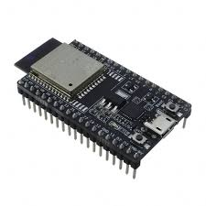
ESP32
Includes many drivers that make programming easier.
Advantages over Arduino nano: speed and memory
2 cores.
 | ESP32 | Arduino nano
Clock rate | 80 MHz | 16 MHz
Memory size | 520 KB SRAM 4 MB flash memory | 2 KB SRAM 32 KB flash

Slide 11
Barcode reader
2D Barcode scanner.
Built in buzzer that we can adapt it to our project.
Supports Arduino development Environment.
Notes:
125 mA = I
Built in buzzer
Built in led

Slide 12
Display
3.2 inch.
240X320 pixels.
Supports Arduino development Environment.
Can be powered with 3.3V.

Slide 13
Arduino developing environment
Supports the ESP32.
Rich collection of libraries for various sensors and communication protocols.
Easy to use and quickly start coding.
Supports wide range of applications.

Slide 14
Until now
Define objectives.
E.E Scheme.
PCB design – in production process.
Case design in process.

Slide 15
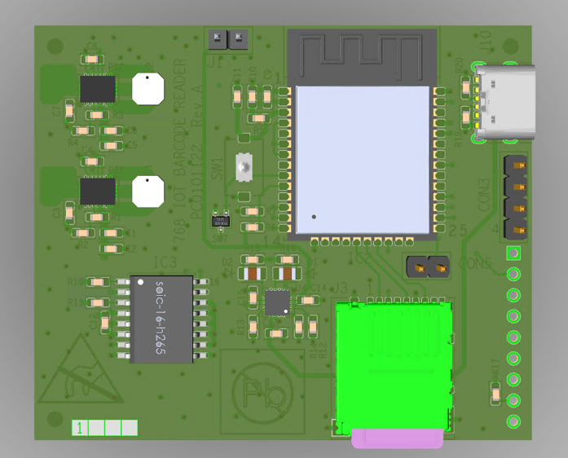
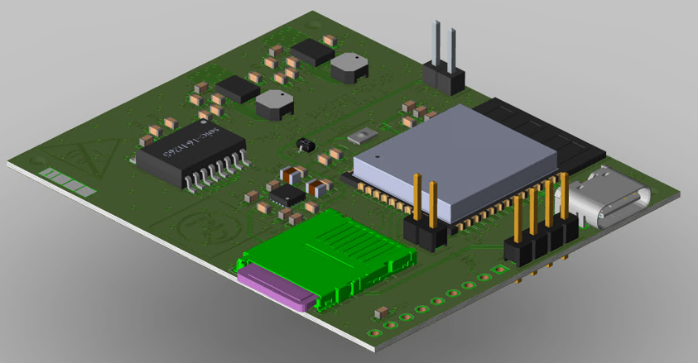
Layout - TOP

Slide 16
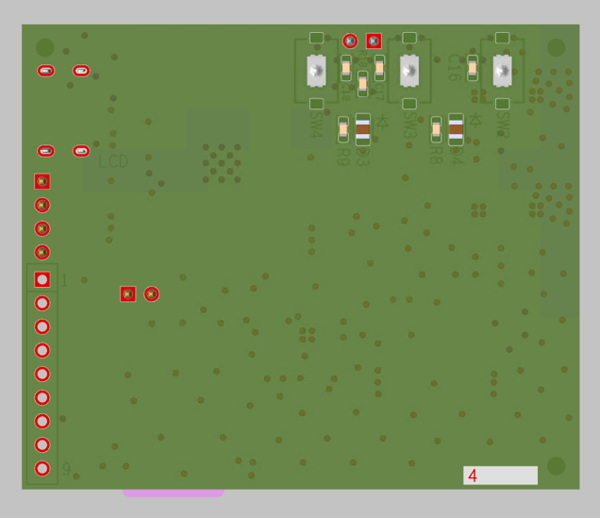
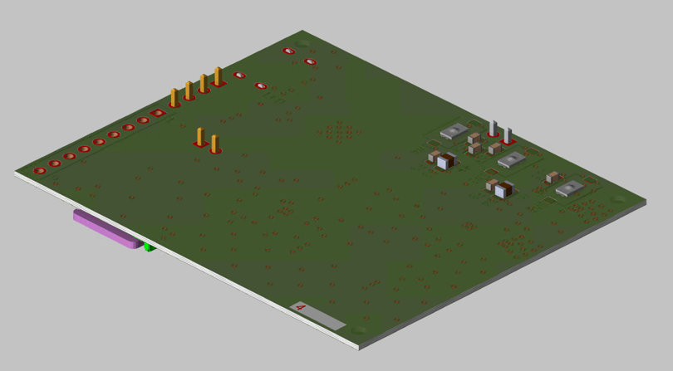
Layout - BOTTOM

Slide 17
Gant diagram
| 18Aug24 | 25Aug24 | 1Sep24 | 22Sep24 | 29Sep24 | 5Oct24 | 19Oct24 |10Nov24
Today
Exams
layout
Designing a case via 3D Printer
Software development
Debug
Hardware bring-up
Integration
Final presentation

